Slide 1
Project Title
Insights for the Marketing Team in the Food & Beverage Industry
Md Mujtaba Alam Siddiqui
Data Enthusiast

Slide 2
Introduction
Codex is a German beverage company launched energy drink in 10 Indian cities.
Marketing team has conducted a survey with 10k respondents and collected the data.
Their goal is to enhance brand awareness, increase market share and guide product development
Now my task here is to analyze the survey data for actionable insights to drive strategic actions in the Indian market.

Slide 3
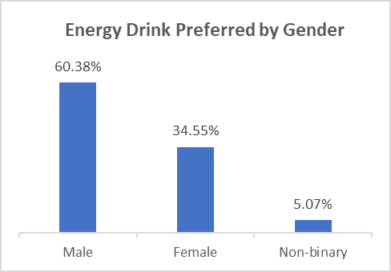
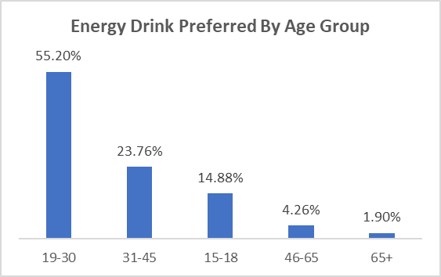
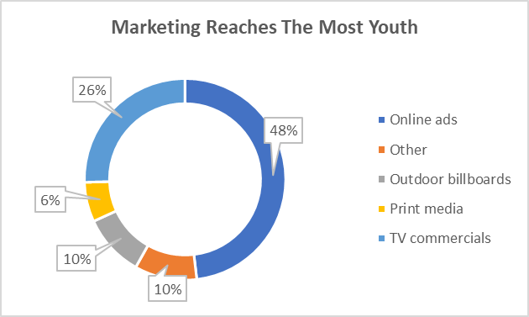
Demographic Insights
a. Who prefers energy drink more?
b. Which age group prefers energy drinks more?
Age group of [19-30] prefers energy drink more (55.2%)
c. Which type of marketing reaches the most Youth
Online ads, TV commercials marketing reaches most youth
Male prefers energy drink more (60.38%)

Slide 4


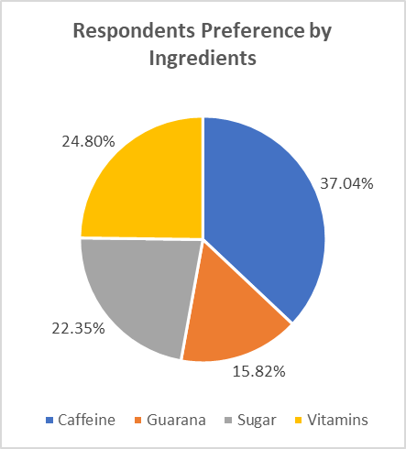
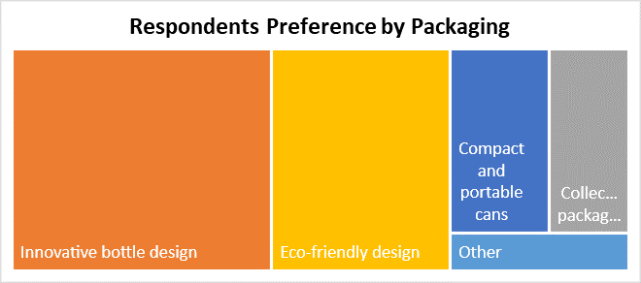
Consumer Preferences
a. What are the preferred ingredients of energy drinks among respondents?
b. What packaging preferences do respondents have for energy drinks?
Caffeine & Vitamins are the preferred ingredients among respondents.
Innovative bottle & Eco-friendly design are the preferred packaging among respondents.

Slide 5

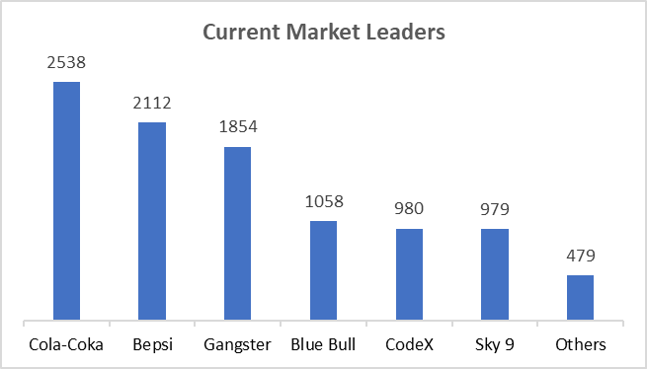
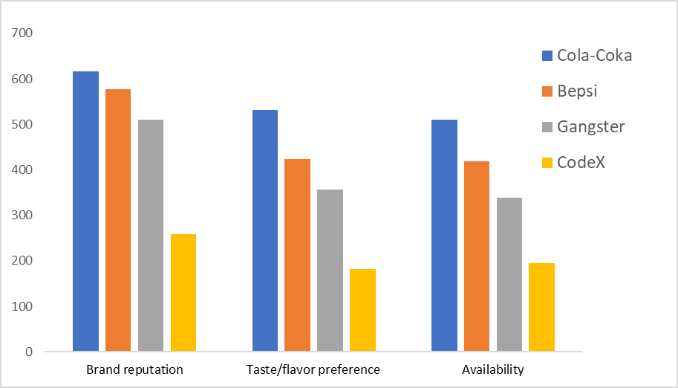
competition Analysis
a. Who are the current market leaders?
Coca-Cola, Bepsi, Gangster are the current market leaders in the food and beverage industry.
b. What are the primary reasons consumers prefer these brands over ours?
Brand reputation, Taste, Availability are the reasons, consumers prefer brands over ours Codex brand

Slide 6


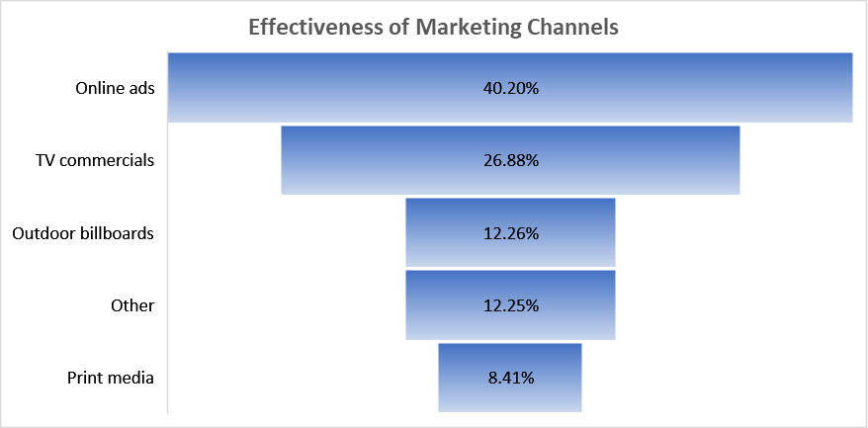
Marketing Channels and Brand Awareness
a. Which marketing channel can be used to reach more customers?
b. How effective are different marketing strategies and channels in reaching our customers?
Majority of the customers around (67%) can be reached by Online ads & TV commercials
We need to mostly target the Youths on social media platforms and TV commercials

Slide 7
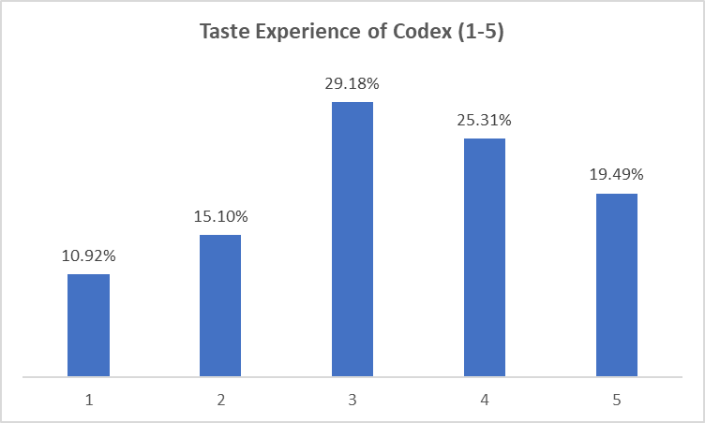
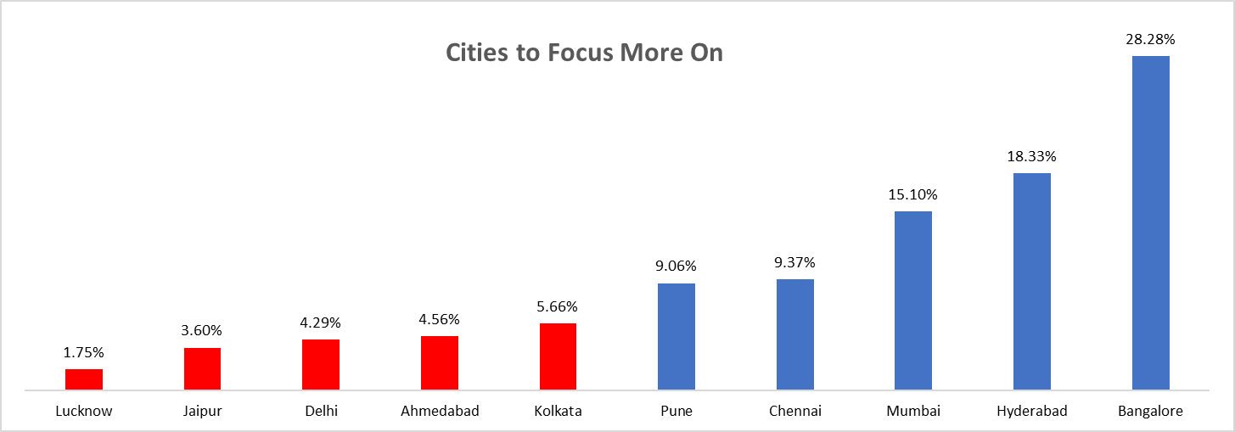
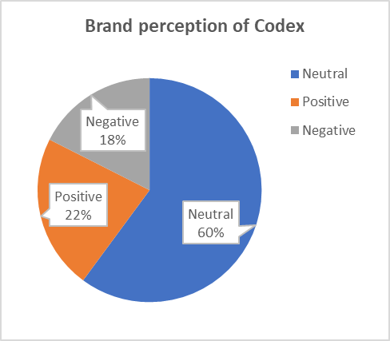
Brand Penetration
What do people think about our brand (overall rating) & which cities do we need to focus more on?
Brand perception of Codex is Neutral & overall ratings as per the taste is 3, around (30%)
We need to focus more on these cities like Lucknow, Jaipur, Delhi, Ahmedabad, Kolkata

Slide 8


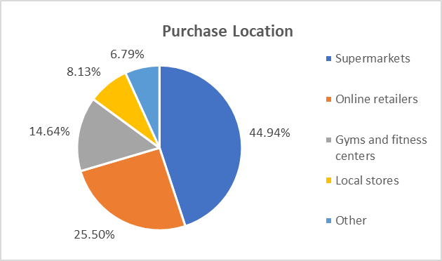
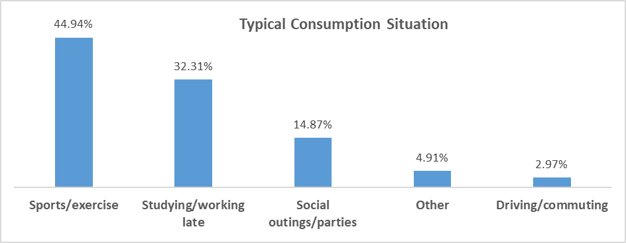
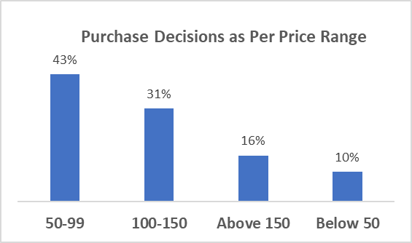
Purchase Behaviour
a. Where do respondents prefer to purchase energy drinks?
b. What are the typical consumption situations for energy drinks?
c. What factors influence respondents purchase decisions?
Mostly from Supermarkets, Online retailers, Gyms (around 85%)
Mostly are Sports/Exercise, Studying/Working Late (around 77%)
Price range is the most important factor in this, mostly the price range from (50 to 150)

Slide 9
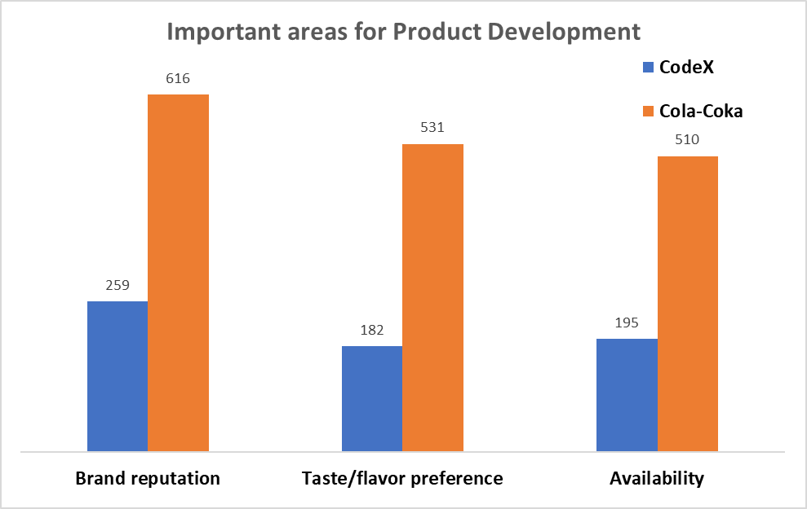
Product Development
Which area of business should we focus more on in our product development?
We have to focus more on Brand Reputation, Availability then Taste

Slide 10
Recommendations for CodeX
1) Immediate Product Improvements
Enhance brand reputation
Improve taste
Ensure wider availability
4) Brand Ambassador (Virat Kohli)
Widespread popularity
Strong appeal among the youth
Association with fitness and dynamic lifestyle
2) Ideal Price Range
Tier 1 cities: ₹100 to ₹150
Tier 2 cities: ₹ 50 to ₹99
5) Target Audience
Youth demographic
Strategic market
3) Marketing Strategies
Online marketing targeting smartphones
Social media campaigns with engaging content
Exclusive online discounts

Slide 11
Thank You
Your time and attention are greatly appreciated.
I am excited about the opportunity to discuss my findings further.
Looking forward to any feedback or questions you may have.
Contact Information:
Email: mujtabavtu11@gmail.com
LinkedIn: https://www.linkedin.com/in/md-mujtaba-alam-siddiqui
Tool Used : Excel (2019)

